Slide 1
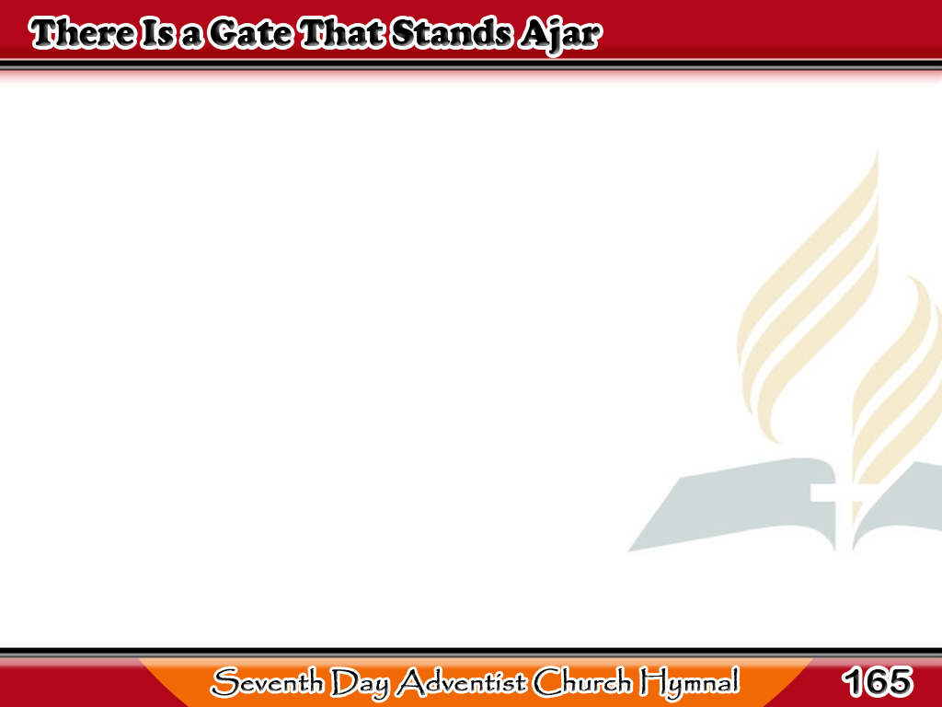
Liwanag ay Lumalabas
There is a gate that stands ajar,
And through its portals gleaming,
A radiance from the cross afar,
The Saviour’s love revealing.
1/4

Slide 2
Liwanag ay Lumalabas
-Refrain-
O depth of mercy! can it be
That gate ajar for me?
For me, for me?
Was left ajar for me?
1/4

Slide 3
Liwanag ay Lumalabas
That gate ajar stands free for all
Who seek through it salvation;
The rich and poor,
the great and small,
Of every tribe and nation.
2/4

Slide 4
Liwanag ay Lumalabas
-Refrain-
O depth of mercy! can it be
That gate ajar for me?
For me, for me?
Was left ajar for me?
2/4

Slide 5
Liwanag ay Lumalabas
Press onward, then,
though foes may frown;
While mercy’s gate is open
3/4

Slide 6
Liwanag ay Lumalabas
Accept the cross,
and win the crown,
Love’s everlasting token.
3/4

Slide 7
Liwanag ay Lumalabas
-Refrain-
O depth of mercy! can it be
That gate ajar for me?
For me, for me?
Was left ajar for me?
3/4

Slide 8
Liwanag ay Lumalabas
Beyond the river’s brink we’ll lay
The cross that here is given,
And bear the crown of life away,
And love Him more in heaven.
4/4

Slide 9
Liwanag ay Lumalabas
-Refrain-
O depth of mercy! can it be
That gate ajar for me?
For me, for me?
Was left ajar for me?
4/4

